Slide 1
Zillow Competition – Round One
@ Kaggle
Last Entry Allowed: Oct 16th, 2017
Scoring: Ended Jan 10th, 2018

Slide 2
Outline
Competition Description
Overview
Scoring
Incentives
Data
Feature Engineering
Basic work
Unusual methods
Neighbourhood
Constrained Similarity measures
Weak & discarded features
Stacking
Add-On Features
Other Teams
Thanks!

Slide 3
Competition Description
Overview
Scoring
Incentives
Data

Slide 4
Overview
Zillow has a proprietary model they use to predict home sales. The objective of the competition is to predict the log errors of their model.
Scoring is based on MAE.
Economic rationale is important, but we might get counter-intuitive results.
logerror=log(Zestimate)−log(SalePrice)

Slide 5
Scoring
Private scoring occurs using only data after the competition closes (Oct 16, 2017)
Private scores were updated three times:
Nov 17
Dec 18
Jan 10 (final)

Slide 6
Incentives
$50,000 in prizes for round one
$1,150,000 in prizes for round two ($1M for first place)
Round two:
Round one is a qualifier – top 100 teams only
Must submit code from round one
Much more data.
Instead of predicting residuals, you aim to have greater accuracy in predicting home sale prices
No prizes if you don’t beat Zillow’s model
(Hopefully Zillow won’t use round one submissions to improve their model)
Edit: Zillow is now offering substantial prizes in the event teams do not beat the benchmark model!

Slide 7
Data
Roughly 150,000 observations with a valid Y value
Roughly 3,000,000 observations without a Y value
Y Variable: Logerrors
58 X variables
substantial redundancy
variable coverage
.
Data Type | Fields
Home Quality | Build date, building quality, type of heating, type of air conditioning,
Property & Home Size | Square feet, number of rooms (by type)
Location | Latitude/longitude
Other | Garage, deck, pool, building type, number of units, taxes paid, assessment values

Slide 8
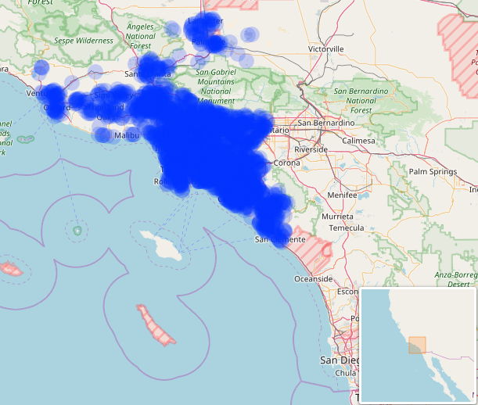
Map of Transactions
Philipp Spachtholz
https://www.kaggle.com/philippsp
https://www.kaggle.com/philippsp/exploratory-analysis-zillow

Slide 9
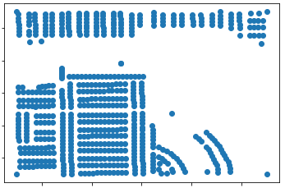
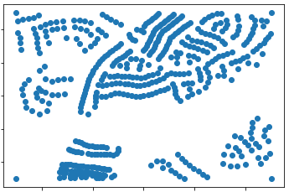
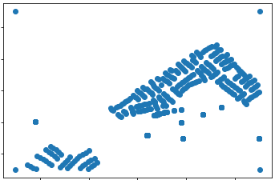
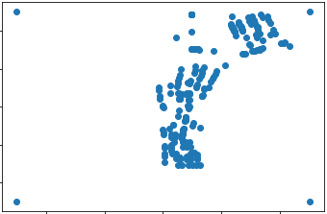
Detailed Neighbourhood Maps
Notes:
Probably a lot of information here. Given a larger dataset, I would use a CNN to predict the color of a central dot (where the color represents the logerror).

Slide 10
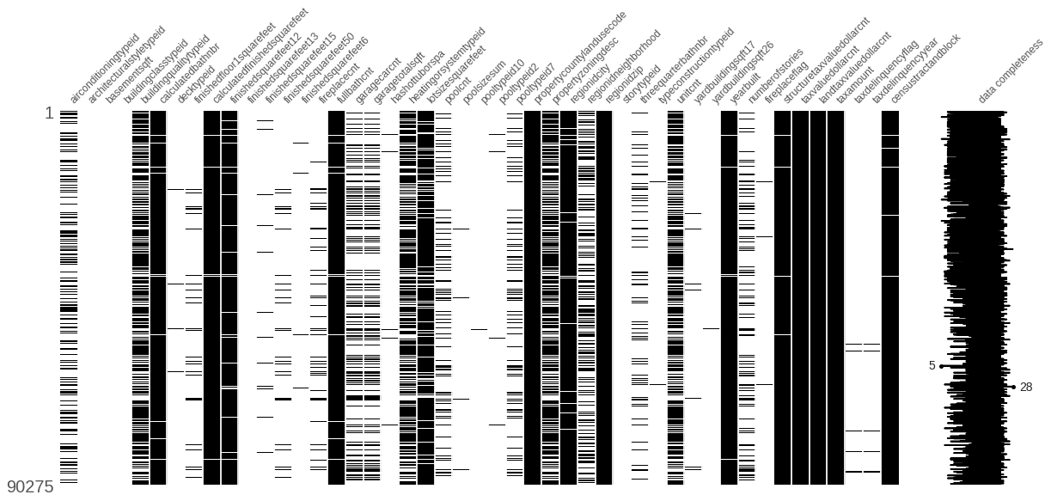
Feature Coverage [White = Missing]
Vivek Srinivasan
https://www.kaggle.com/viveksrinivasan
https://www.kaggle.com/viveksrinivasan/zillow-eda-on-missing-values-multicollinearity

Slide 11
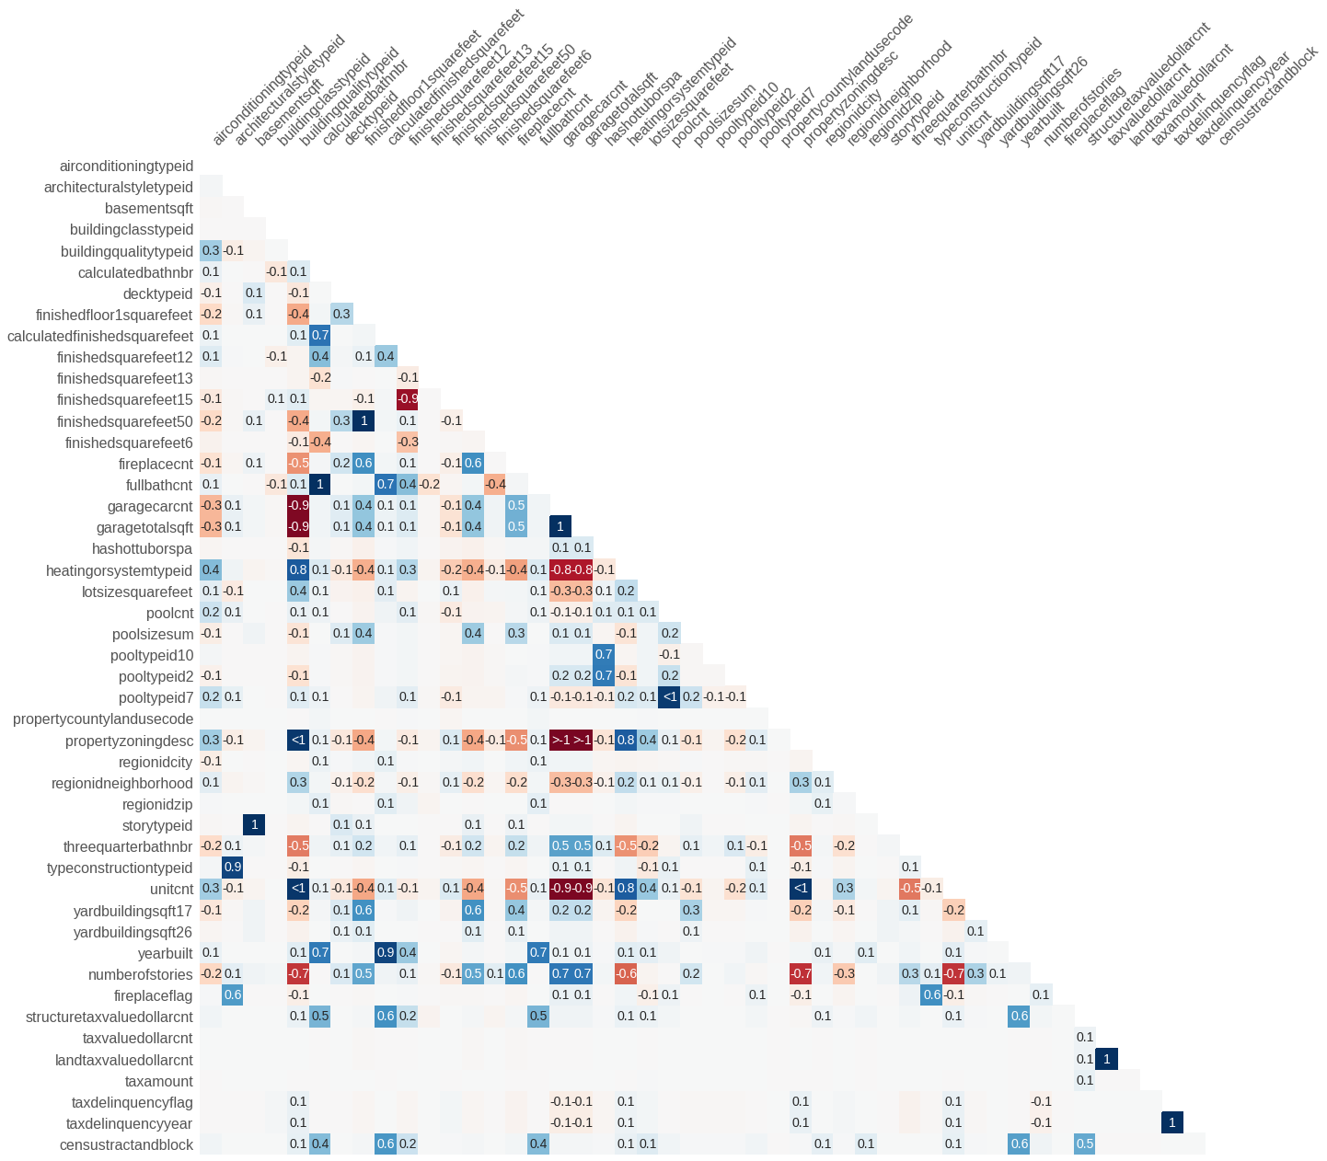
Feature Correlation
Vivek Srinivasan
https://www.kaggle.com/viveksrinivasan
https://www.kaggle.com/viveksrinivasan/zillow-eda-on-missing-values-multicollinearity

Slide 12
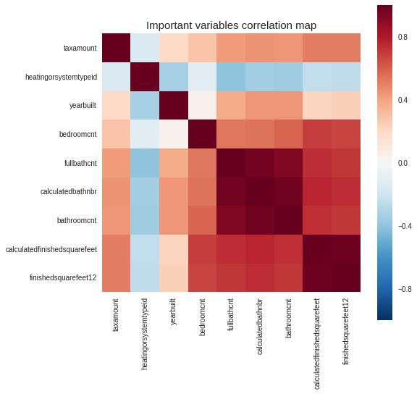
Correlation of Most Important Features
Sudalai Rajkumar
https://www.kaggle.com/sudalairajkumar
https://www.kaggle.com/sudalairajkumar/simple-exploration-notebook-zillow-prize

Slide 13
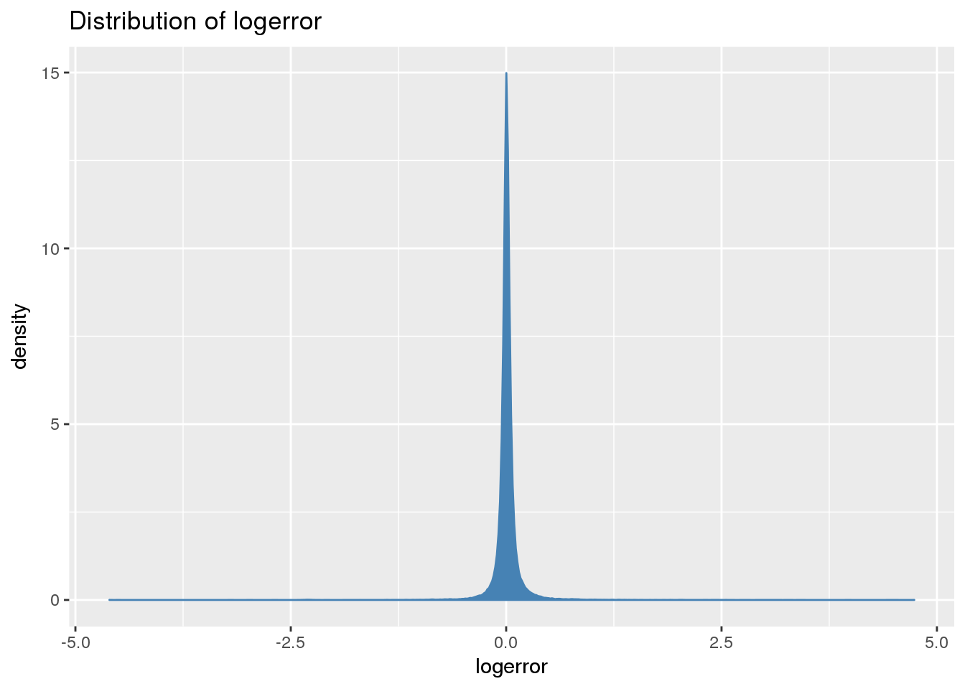
Distribution of Y Variable
Troy Walters
https://www.kaggle.com/captcalculator
https://www.kaggle.com/captcalculator/a-very-extensive-zillow-exploratory-analysis

Slide 14
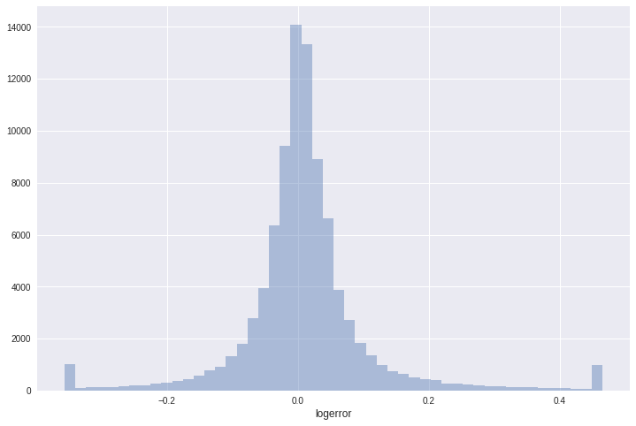
Distribution of Y Variable
Sudalai Rajkumar
https://www.kaggle.com/sudalairajkumar
https://www.kaggle.com/sudalairajkumar/simple-exploration-notebook-zillow-prize

Slide 15
Solution Explored
Rankings: (/3800)
Public #17
Private first month: #11
Private second month: #19
Private Final: #17
Very limited disclosures so far – essentially all highly-ranked participants are withholding their strategies so they can be re-used in stage two.

Slide 16
MAE Private Score by Rank
Current Zillow Model

Slide 17
Feature Design
Basic work
Unusual methods
Weak & discarded features

Slide 18
Basic Feature Engineering
New features:
Structure value per square foot
Average room size
Value of structure relative to land
& others
Categorical variables treatment: use some intuition
If they have a natural order -> integers
For example: Air conditioning type – generate integer values based on a basic assessment of quality
If they are similar -> group
(particularly if there are few observations)
For example: quadruplex, townhome

Slide 19
Neighbourhood (1/6)
Intuition:
Location, location, location
Use information other participants might overlook – the set of houses for which there is no corresponding Y-variable.
We used two methods to extract information from these houses:
Average Neighbour:
Average feature values for nearby homes
Average difference in feature values vs nearby homes
Each Neighbour:
This is a lot of variables. We will have to constrain the relationships.

Slide 20
Neighbourhood (2/6)
First, model the log errors using information about the home. Using a regression as a representation of the problem, we have:
Where:
X1 through Xn are features of the houses whose log errors we are modeling
We think the characteristics of the neighbours also matter. If we were to include the features of the nearest house we could have:
Where:
XN1 through XNn are features of the neighbouring house

Slide 21
Neighbourhood (3/6)
Otherwise we could obtain a slightly worse but similar solution to (2) by modeling the residuals of (1) as in:

Slide 22
Neighbourhood (4/6)
Although (1) and (3) are less efficient than (2), we can more think of the information in (3) as being incremental over equation (1), whereas in (2) the coefficients are interdependent. This simplicity is going to be useful as we will now go deeper…
We want to add more than the nearest home. We want to include information about all nearby homes.
Notes:
If we were to do this directly in the spirit of (2), then the equation would get very big and we would have multicollinearity issues.
Adding layers as in (3) would also not work very well without some fancy math. So instead we just modeled ε1 with information from each of the neighbours – and we will deal with their overlap later.

Slide 23
Neighbourhood (5/6)
So now we get:
Where “SN” and “TN” refer to “second nearest” and “third nearest,” respectively.
We keep going until 500.
Since we expect the coefficients of these equations to be highly related, we want to impose a little more structure…

Slide 24
Neighbourhood (6/6)
We concatenate all 500 equations together, and to each one we add one more x variable – a number from 1 to 500, where the nearest gets a 1 and the furthest a 500.
Now for this to really work, we need to count on that last term to act as an interactor on all the other variables, so we don’t use a regression, but instead a GBRT (many other options would also work).
This gives us 500 estimates of each home’s residual based on each of the 500 nearest neighbours.
Finally, we can take the 500 different estimates of each home’s residual and use each as a new variable (or simply take a weighted average).
Notes:
Could use differences instead / in addition to.

Slide 25
(New Topic) Constrained Similarity Fitting
Given the limited data set, it may make sense to impose constraints on the fitting in order to obtain more robust results.
Create a preference for using features that are important throughout their full spectrum of values
More likely to be economically important (vs noise)
Weights determined by the whole dataset, not parts of the dataset.

Slide 26
Illustrating the Idea
For which of the following two factors would you be more confident in using (as a forecast) the average value between the red lines?
(The numbers are identical)

Slide 28
Argument #1
The first feature is likely to have substantial economic importance, since it describes substantial variation across its entire spectrum.
The second feature may have economic importance, but it is relatively likely to be noise.
This would in general lead us to preference the split on the first factor over the second factor.

Slide 29
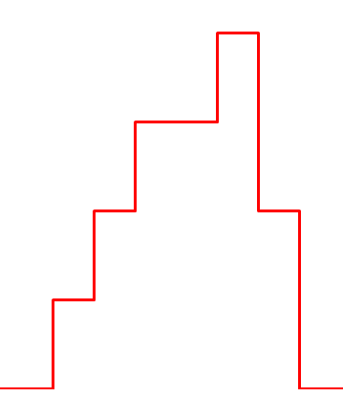
GB Decision Tree Weights

Slide 30
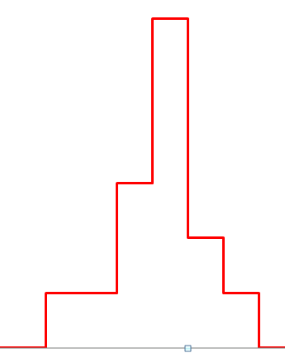
GB Decision Tree Weights

Slide 31
Argument #2
We may want to force a similar importance to nearby observations across the entire spectrum of a feature
Rather than have discontinuities that are dependent on the local structure.

Slide 32
GB Decision Tree Weights

Slide 33
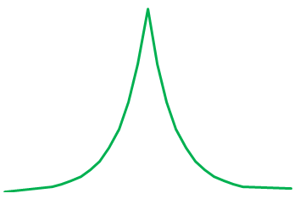
Alternative Weights (equal functions of nearby observations)

Slide 34

Process (Constrained Function)
Create measures of pairwise similarity for X and Y variables.
Fit new Y with new X.
Pairwise Relationships
Home1 Home2 … Home N
Home N ... Home 2 Home 1
Notes:
Note: we ended up reducing the size of these matrices substantially to deal with memory limitations.

Slide 35

Process (Constrained Function)
Correlation Matrix
Home1 Home2 … Home N
Create measures of pairwise similarity for X and Y variables.
Fit new Y with new X.
Using the model from (2), generate an expected correlation matrix between each home and all homes in the training set.
Extract multivariate coefficients from matrix (required Tihkonov regularization).
Multiply coefficients by training log errors, sum result.
New feature (or into second layer of stacking)
Note: We prohibited matches with a time difference of less than 30 days; this was to mirror the test set prediction circumstances (so this wouldn’t take too much explanatory power from correlated variables that have more stable power over longer horizons).
Home N ... Home 2 Home 1
Multivariate Coefs to Predict Home 1
Beta
Log Errors
Home1
. NaN
.
.
.
Home N ... Home 2 Home 1
Home N ... Home 2 Home 1

Slide 36
Other Items we Explored
Some of these had explanatory power, but almost all were dropped due to tradeoffs between their limited benefits and computational cost / complexity.
Note: no outside data.
Fit assessment values with the other features. Use the residual as a new feature.
Width of the street (proxy for traffic).
The direction the home was facing.
Density of the neighborhood.
Near a “park” (empty space)
Proportion of nearby homes that were recently sold.
Prior same-home sales
This one was odd – there appears to be a structural break ~ on Jan 1st 2017.

Slide 37
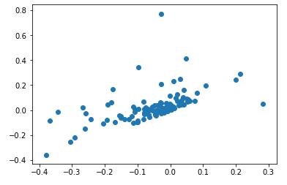
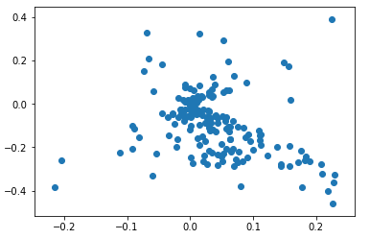
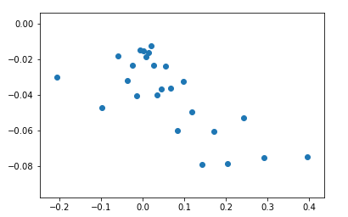
Resales
2016 for both sales
2017 for both sales
Residual of Second Sale
Residual of Second Sale
Slope = 1
Slope = -1
Slope = 1
Residual of First Sale
Residual of First Sale
2016 for first sale; 2017 for second

Slide 38
Stacking

Slide 39
Stacking
First/first serious competition; we didn’t have any code built up, so this part was pretty limited.
LightGBM, XGBoost, ANN (MLP), OLS, Constrained OLS.
Three layers
Then last day: Add Catboost @ ~45% weight with no parameter tuning.
Notes:
I expect the gain from a better stacking solution would be quite substantial.

Slide 40
Stacking - Wrinkle
If you have priors of different strength for your features, you would like to reflect this in your modeling via shrinkage of observed relationships.
Since most ML functions are not built to handle priors of different strength, we instead did this by modeling segregated feature sets in the first layer.

Slide 41
Stacking Add training vs test
All Features
5x LGBM, 5x XGB, 3x ANN, OLS
High-Expectation Features
5x LGBM, 5x XGB, 3x ANN, OLS
Low-Expectation Features
5x LGBM, 5x XGB, 3x ANN, OLS
2x LGBM, 2x XGB, 2x ANN, COLS
XGB, ANN, COLS
Average
+ Catboost

Slide 42
Add-On Features

Slide 43
2017 Data Changes: Fit to Residuals of Overall Model on 2017 Data Only
Intuition:
The aforementioned resale idea.
A new bathroom is not the same as a bathroom (etc.).
New Y variable: Residuals to our other model (using 2016 & 2017 data) – but using only 2017 values.
New X variable: Changes in the data (only where the change was meaningful).
Notes:
We cannot use these changes with 2016 data because it is forward-looking.
We used these features on residuals of our general model because they are correlated with other features that existed for both 2016 and 2017, and we weren’t confident in the models’ ability to control for the inconsistent feature correlations across time.

Slide 44
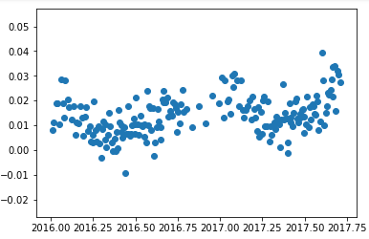
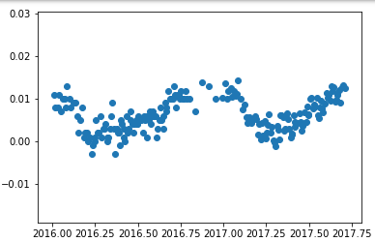
Average Forecast
Estimating the future logerror is difficult:
Two final submissions are allowed. I entered one at 0.0115 and another at 0.0155.
Average LogError by Time
Median LogError by Time

Slide 45
Other Teams

Slide 46
Other Successful Solutions
Some participants with little kaggle experience but decent scores got major boosts shortly after pairing with experienced kagglers – likely by running their features through well designed parameter tuning & model stacking code.
Genetic algorithms.

Slide 47
Thanks!
Morgan Gough:
Background: Research & modeling
Dashiell Gough:
Background: Software, ML, & Marketing

